Slide 1



Course: Image Processing 31651
Assignment #31
Geometrical Transforms – version 2
Photo of the student | Shorten Name | ID (4 last digits)
 | shienfeld | 1950 | Student #1
 | pony | 2210 | Student #2
 | akimov | 7939 | Student #3
Photo of the student | Shorten Name | ID (4 last digits)
 | shienfeld | 1950 | Student #1
 | pony | 2210 | Student #2
 | akimov | 7939 | Student #3

Slide 2
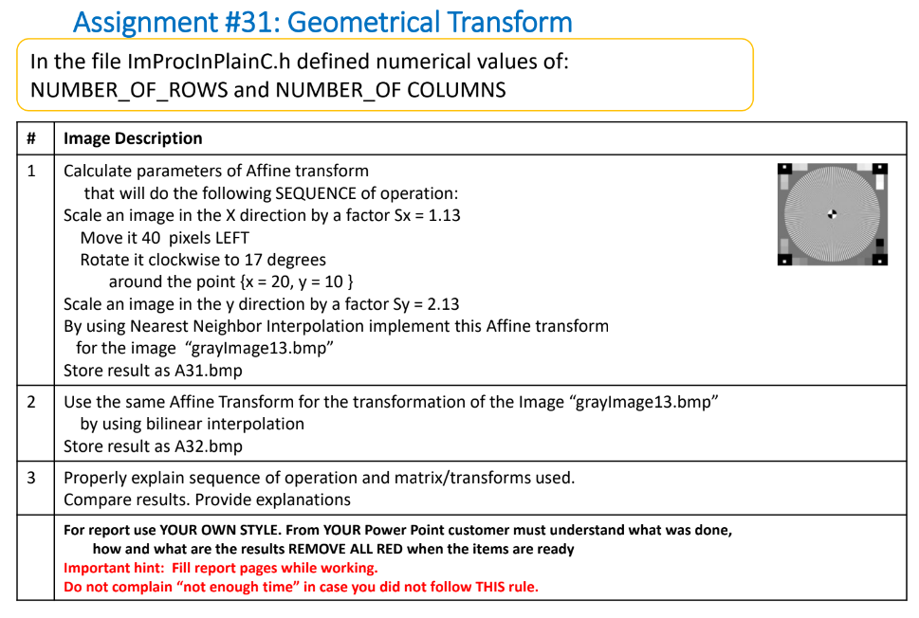

Slide 3
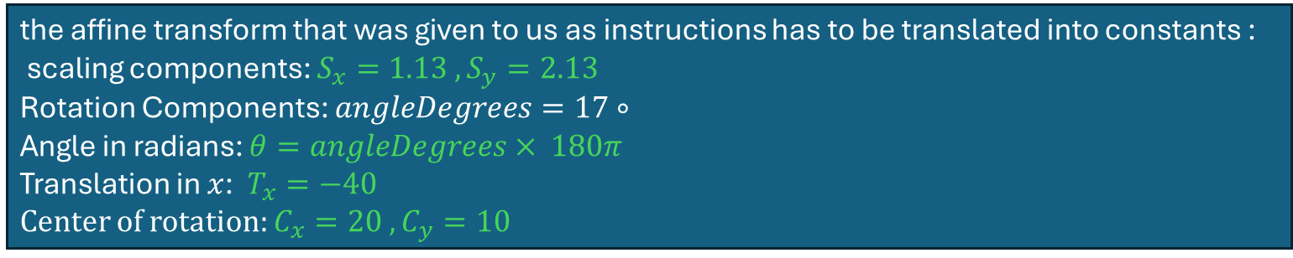
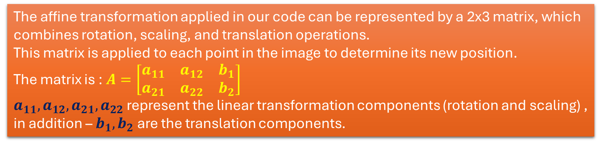
31.1 – mathematical background about affine transformations-part 1
We are going to use several affine transformations according to the demand of the task – all the transformations (operations) will be modeled using matrix operations :
The affine transformation applied in our code can be represented by a 2x3 matrix, which combines rotation, scaling, and translation operations.
This matrix is applied to each point in the image to determine its new position.
The matrix is :$A=\left[\begin{matrix}a_{11} & a_{12} & b_{1} \\ a_{21} & a_{22} & b_{2}\end{matrix}\right]$
$a_{11}​,a_{12}​,a_{21}​,a_{22}$​ represent the linear transformation components (rotation and scaling) , in addition – $b_{1}​,b_{2}$​ are the translation components.
the affine transform that was given to us as instructions has to be translated into constants :
scaling components: $S_{x}=1.13 ,S_{y}=2.13$
Rotation Components: $angleDegrees=17∘$
Angle in radians: $θ=angleDegrees× 180π​$
Translation in $x$: $T_{x}=−40$
Center of rotation: $C_{x}=20 , C_{y}=10$

Slide 4
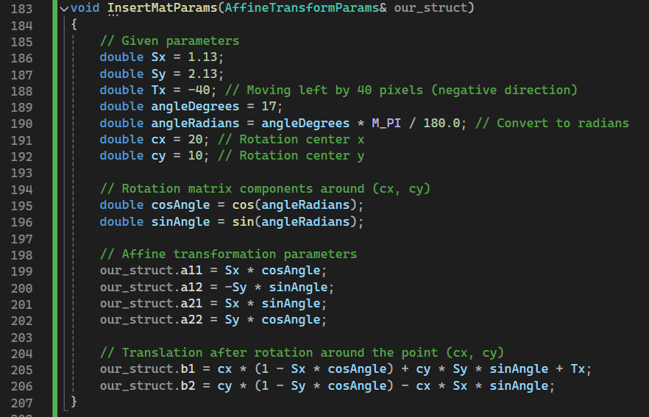





31.1 – mathematical background about affine transformations-part 2
The relations between the constants and the components of the affine matrix are:
$$a_{11}​ =S_{x}∗cos⁡(θ)$$
$$a_{21}​ =S_{x}∗sin⁡(x)$$
$$b_{1}=c_{x}∗\left(1−S_{x}∗cos\left(θ\right)\right)+C_{y}∗S_{y}∗sin\left(θ\right)+T_{x}$$
$$a_{12}​ ={−S}_{y}∗sin⁡(θ)$$
$$a_{22}​ =S_{x}∗cos⁡(x)$$
$$b_{2}=c_{y}∗\left(1−S_{y}∗cos\left(θ\right)\right)−C_{x}∗S_{x}∗sin⁡(θ)$$

Slide 5
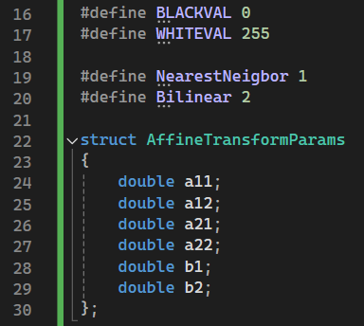
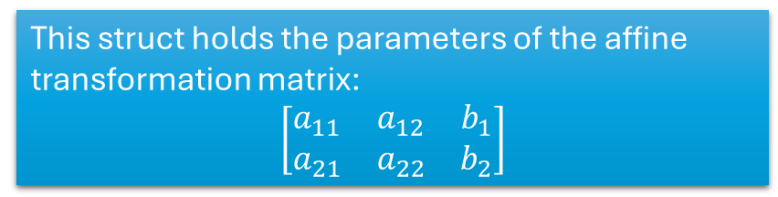
31.2 –”AffineTransformParams” struct and constants
NearestNeigbor and Bilinear: These are the two methods we are going to use.
AffineTransformParams holds six coefficients (matrices in fact) that control how the image is transformed (stretched, moved, and rotated).
a11, a12, a21, a22 - control how the image is stretched or rotated.
b1, b2 control how the image is moved (up, down, left, or right).
This struct holds the parameters of the affine transformation matrix:
$$\left[\begin{matrix}a_{11} & a_{12} & b_{1} \\ a_{21} & a_{22} & b_{2}\end{matrix}\right]$$

Slide 6
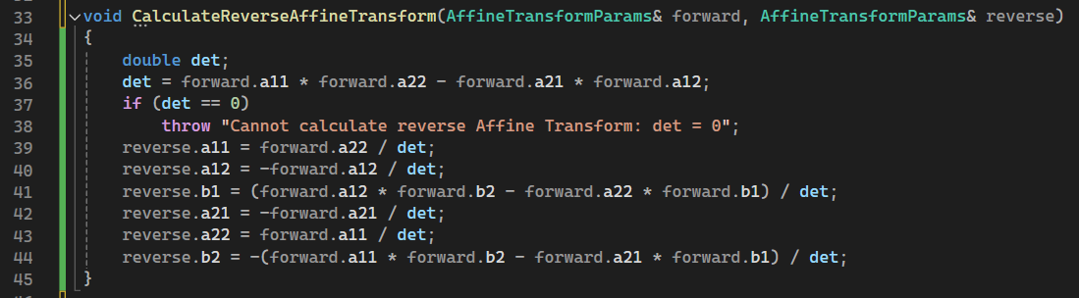

31.3 –” CalculateReverseAffineTransform” function – part 1
This function calculates the inverse of the affine transformation. If you think of the affine transformation as an operation that maps coordinates from the original image to the transformed image, this function reverses that operation.
An affine transformation in 2D space can be represented by a matrix equation of the form:
$$\left(\begin{matrix}X^{′} \\ Y^{′}\end{matrix}\right)=\left(\begin{matrix}a_{11} & a_{12} \\ a_{21} & a_{22}\end{matrix}\right)\left(\begin{matrix}X \\ Y\end{matrix}\right)+\left(\begin{matrix}b_{1} \\ b_{2}\end{matrix}\right)$$
The goal of this function is to compute the inverse transformation, which allows you to map coordinates from the transformed (destination) image back to the original (source) image.

Slide 7
31.3 –” CalculateReverseAffineTransform” function – part 2
Important question we asked ourselves during the study on that task: (as a repair of version 1 where we didn’t use the reverse transform)
why do we even need the reverse affine transform (inverse transform):
After transforming the image, we need to figure out where each pixel in the destination image comes from in the source image.
This is crucial because the transformation may not map pixel-to-pixel perfectly. Instead, we have fractional pixel coordinates in the source image that need to be interpolated.
The inverse transform tells you how to "go back" from the destination coordinates to find the corresponding original coordinates in the source image.

Slide 8
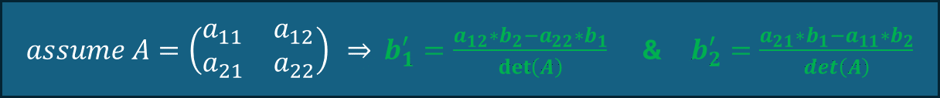
31.3 –” CalculateReverseAffineTransform” function – part 3
The determinant is crucial because it indicates whether the matrix is invertible. If the determinant is 0, the matrix has no inverse, meaning the transformation cannot be reversed.
$assume A=\left(\begin{matrix}a_{11} & a_{12} \\ a_{21} & a_{22}\end{matrix}\right)$ $⇒$ ${\left(\begin{matrix}a_{11} & a_{12} \\ a_{21} & a_{22}\end{matrix}\right)}^{−1}=\frac{1}{det\left(A\right)}∗\left(\begin{matrix}a_{22} & −a_{12} \\ −a_{21} & a_{11}\end{matrix}\right)$
$assume A=\left(\begin{matrix}a_{11} & a_{12} \\ a_{21} & a_{22}\end{matrix}\right)$ $⇒$ $b_{1}^{′}=\frac{a_{12}∗b_{2}−a_{22}∗b_{1}}{\det\left(A\right)}$ & $b_{2}^{′}=\frac{a_{21}∗b_{1}−a_{11}∗b_{2}}{\det\left(A\right)}$

Slide 9
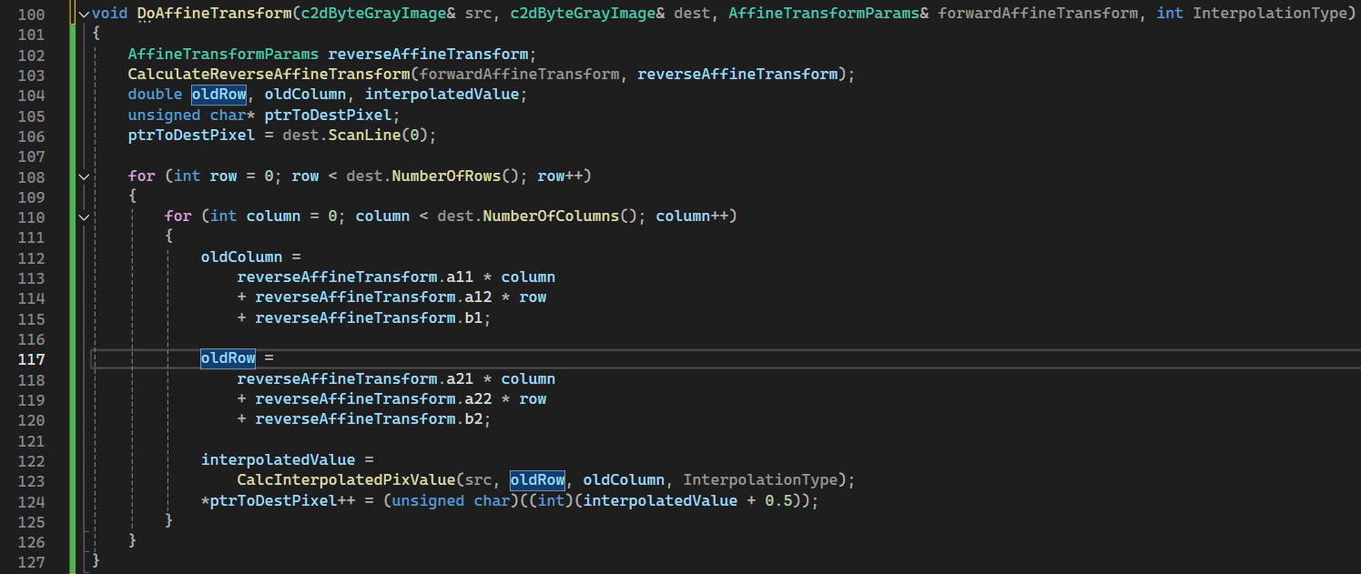
31.4 –” DoAffineTransform” function – part 1
The DoAffineTransform function is responsible for applying an affine transformation to an image. It takes a source image, a destination image, and the affine transformation parameters, and it generates a new image in which the transformation has been applied.
Deeper step by step explanation about that function – in the next slides

Slide 10

31.4 –” DoAffineTransform” function – part 2
1
The function starts by calculating the reverse affine transformation using the CalculateReverseAffineTransform function.
Variables oldRow and oldColumn store the coordinates in the source image corresponding to the current pixel in the destination image.
interpolatedValue will hold the pixel value after interpolation.
ptrToDestPixel is a pointer to the first pixel in the destination image, used to directly write pixel values into the image.
2

Slide 11
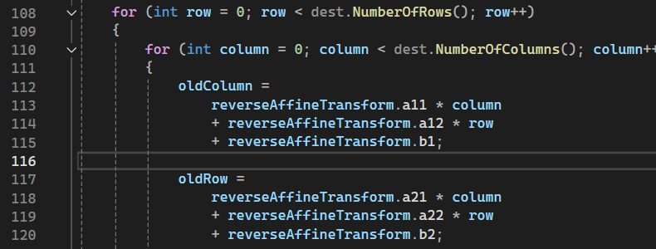
31.4 –” DoAffineTransform” function – part 3
For each pixel (row, column) in the destination image, the function calculates the corresponding pixel coordinates (oldRow, oldColumn) in the source image using the reverse affine transformation.
3
4
The function then uses the CalcInterpolatedPixValue function to determine the pixel value at (oldRow, oldColumn) in the source image , and then rounded to the nearest integer and written to the destination image.

Slide 12
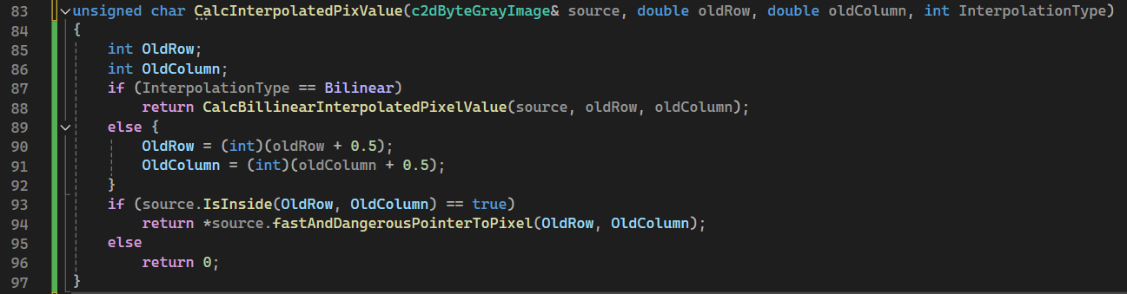
31.5 –” CalcInterpolatedPixValue ” function
That is responsible for determining the pixel value at a non-integer coordinate (after the transformation, the calculated pixel position may not align exactly with the grid of pixel coordinates in the source image).
Depending on the interpolation method used, the function computes the pixel value by either:
Nearest Neighbor Interpolation: Selecting the nearest pixel’s value directly.
Bilinear Interpolation: Calculating a weighted average of the four closest pixels to create a smoother transition.

Slide 13
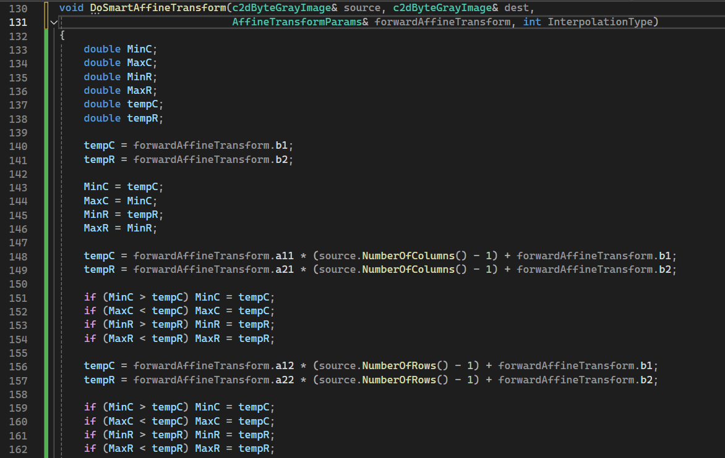
31.6 –” DoSmartAffineTransform ” function – part 1
These variables are used to track the minimum and maximum values of the transformed coordinates. This is essential because after applying the affine transformation, the image might no longer fit within its original dimensions.
Calculation of the transformed coordinates of the four corners of the source image:
Top-right corner (0, NumberOfColumns - 1)
Bottom-left corner (NumberOfRows - 1, 0)
Bottom-right corner (NumberOfRows - 1, NumberOfColumns - 1)
For each corner, the transformed coordinates are calculated using the forward affine transformation matrix

Slide 14
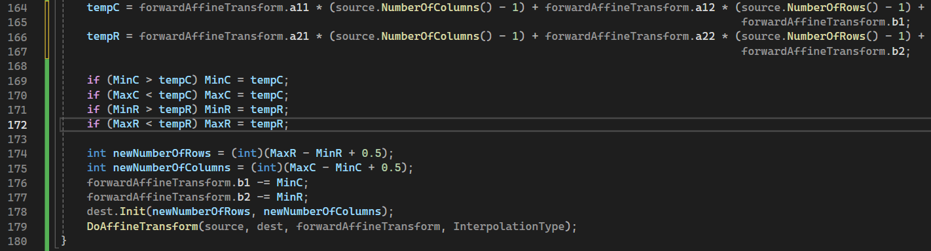
31.6 –” DoSmartAffineTransform ” function – part 2
After determining the minimum and maximum transformed coordinates, the new dimensions of the destination image are calculated
Finally, the DoAffineTransform function is called to apply the actual affine transformation to the source image, filling in the destination image with the appropriately transformed pixels.
DoSmartAffineTransform function is designed to handle the affine transformation by dynamically adjusting the size of the destination image to fully encompass the transformed source image.
This ensures that the entire content of the transformed image is captured without being cut off or losing parts of the image.

Slide 15
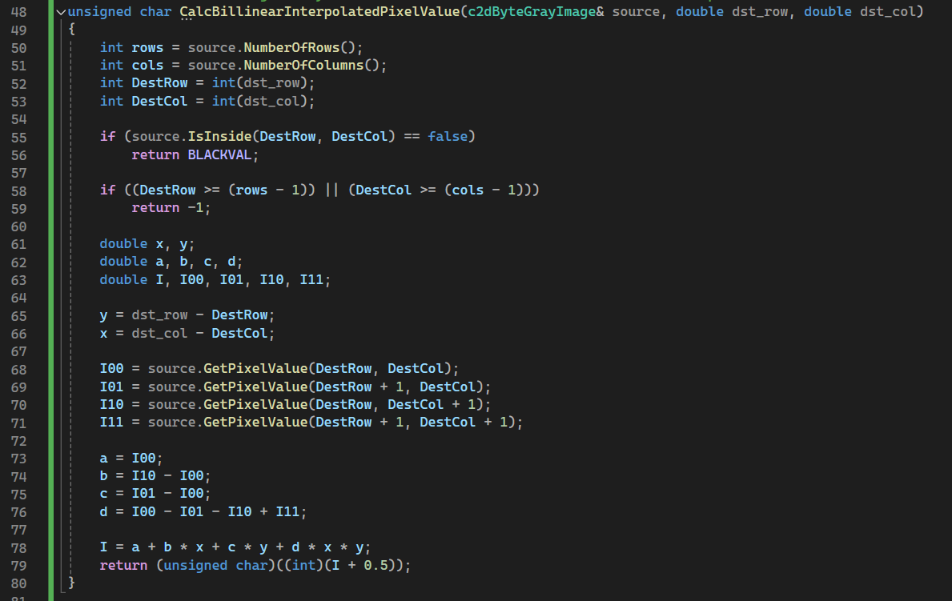
31.7 –” CalcBillinearInterpolatedPixelValue ” function
The Bilinear interpolation uses the four nearest pixel values in a 2x2 neighborhood to compute a weighted average. The weights are based on the fractional distance of the target pixel from the integer pixel coordinates.
The four nearest pixel values in the 2x2 neighborhood are I00 , I11,I01 , I10

Slide 16
31.8 –” InsertMatParams” function
That function is responsible for initializing the affine transformation matrix. This matrix defines how the source image will be transformed, including operations like scaling, rotation, and translation. The function calculates the elements of this matrix based on given transformation parameters and then stores them in the AffineTransformParams structure.

Slide 17
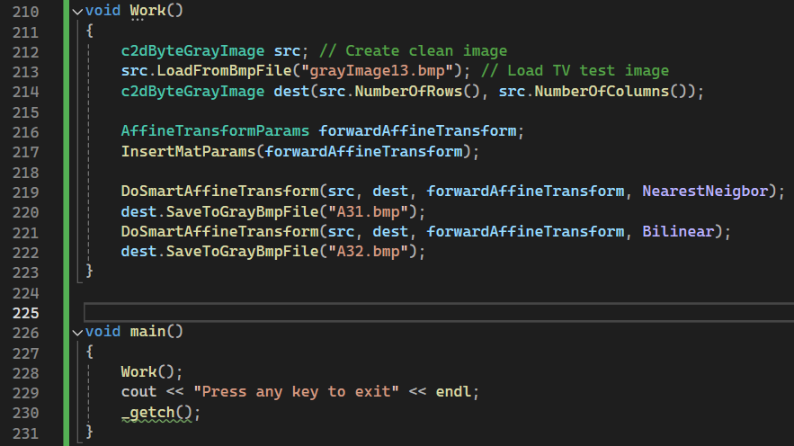
31.9 – the “main” function
The image grayImage13.bmp is loaded into the src object, which represents the source image.
The dest object is prepared to hold the transformed image.
The affine transformation is applied twice, once using Nearest Neighbor interpolation (result saved as A31.bmp) and once using Bilinear interpolation (result saved as A32.bmp).

Slide 18
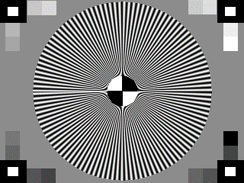
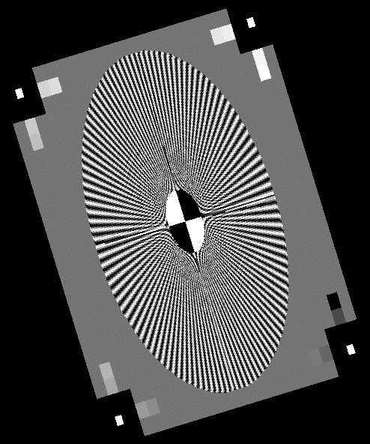
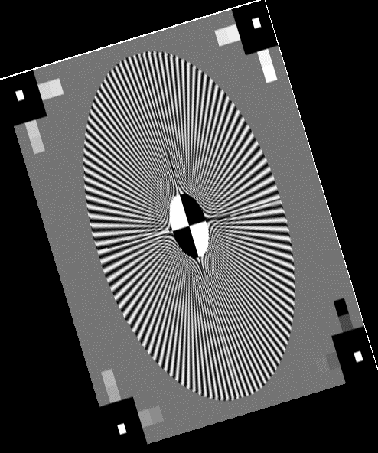
31.10 - Resulted photographs – “A31.bmp”,”A32.bmp”
“grayImage13.bmp” - input image
The size of the created images has been changed from 320x240 to 494x592
Pay attention that A31.bmp and A32.bmp are larger in size than presented here. Sized only to fit the slide of the PowerPoint
“A31.bmp” - Created by using nearest neighbor interpolation
“A32.bmp” - Created by using
bilinear interpolation

Slide 19
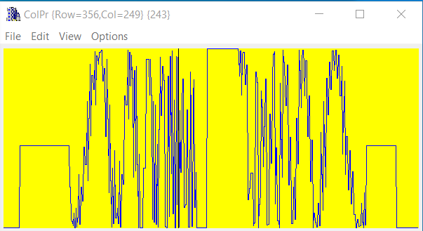
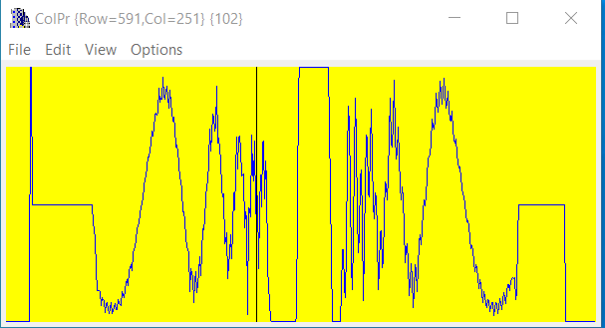

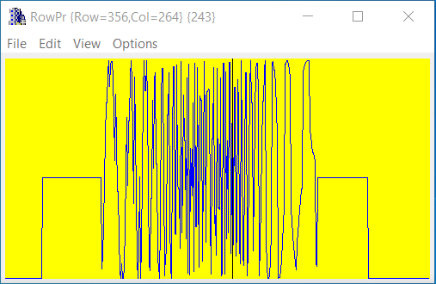
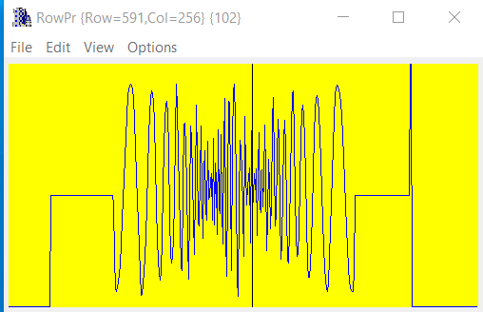
31.11 –profilers of Resulted photographs – “A31.bmp”,”A32.bmp” – part 1
A31.bmp
A32.bmp

Slide 20
31.11 –profilers of Resulted photographs – “A31.bmp”,”A32.bmp” – part 2
Conclusions about the profilers: (presented at part 1)
The column profile in the bilinear interpolation shows smoother transitions between pixel values compared to the nearest neighbor interpolation.
The curves are more gradual, with fewer sharp jumps.
Like the column profile, the row profile in the bilinear interpolation also exhibits smoother transitions. There are still fluctuations, but they are less abrupt than in the nearest neighbor profile.
Bilinear interpolation introduces more intermediate grayscale levels, leading to a smoother and more continuous intensity distribution, whereas nearest neighbor interpolation maintains more discrete levels, often resulting in a more binary appearance.
More ?

Slide 21
31.12 –deeper look at the results-“A31.bmp” vs ”A32.bmp” – part 1
A31.bmp
A32.bmp
Pay attention – here the images are in their original size 494x592
2
2
1
1
Numbers 1-4 are points to look at and are explained next slide
3
3
4
4

Slide 22

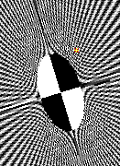
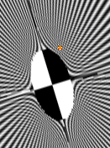



31.12 –deeper look at the results-“A31.bmp” vs ”A32.bmp” – part 1
The black straight lines are much more disrupted in the A31.bmp.
The small white rectangles in the corners – their outline are much more disrupted in the A31.bmp.
The area around the center circle is much more disrupted – a lot of added noise in A31.bmp.
The black and white lines (like sun) that start at the center circle are much more disrupted in the A31.bmp

Slide 23
31.13 –comparison between the results on the basis of critirias
A31.bmp
A32.bmp
Image Characteristics: The output image show noticeable pixelation, with sharp transitions between pixel colors. This is because it doesn't consider surrounding pixels, leading to lower quality in areas where the image was resized or rotated.
Image Characteristics: The output image is generally smoother, with less pixelation and better-preserved details. Edges and gradients are handled better compared to the nearest neighbor method, making the image appear more natural.
Edges in the image appear jagged or "staircased," especially noticeable along diagonal lines or curves. This occurs because the interpolation does not introduce any new pixel values, just replicates existing ones.
Edges are smoother with this method.
The interpolation creates new pixel values by averaging the nearest pixels, leading to softer transitions along edges. This reduces the staircasing effect seen in nearest neighbor interpolation.
The image display more artifacts, such as aliasing, due to the sharp transitions between pixels. These artifacts are more prominent in areas with high contrast or fine details.
Bilinear interpolation generally introduces fewer artifacts. However, it might slightly blur sharp edges due to the averaging of pixel values. This trade-off is often acceptable for a smoother overall appearance.
In summary, bilinear interpolation generally provides better visual quality for transformed images by producing smoother transitions and reducing pixelation, while nearest neighbor interpolation is simpler and faster but can lead to a more pixelated appearance with more noticeable artifacts.

Slide 24
31.14 – What did we learn ?
1) To use two algorithms that can create the same result in different ways: Bilinear interpolation and nearest neighbor.
2) To acknowledge what is interpolation and how it use it.
3) How to use Nearest Neighbor Interpolation algorithm to rotate the image.
4) How to use Bilinear Interpolation algorithm to rotate the image.
5) To apply sequence of operations on an image (move it, scale it, rotate it around the point).

